Slide 1

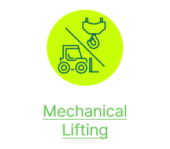

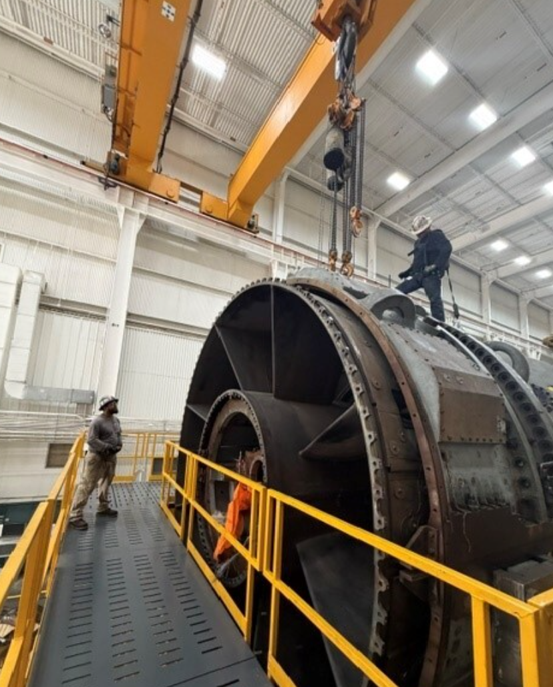
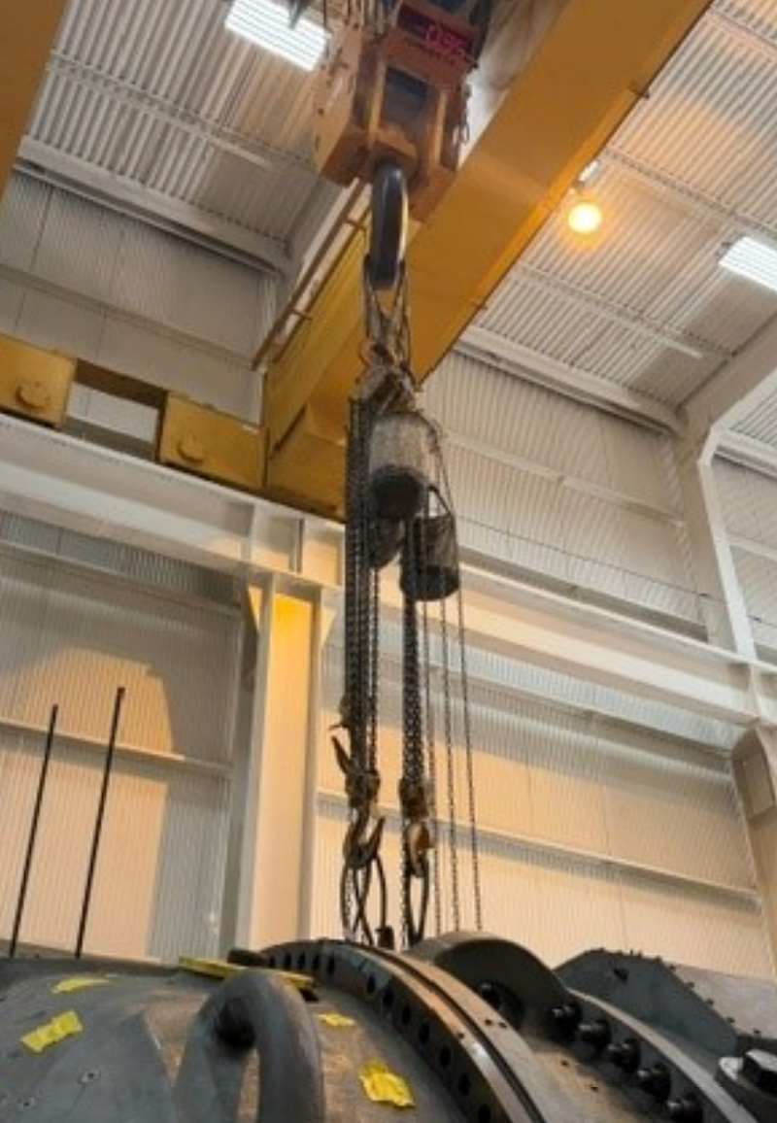
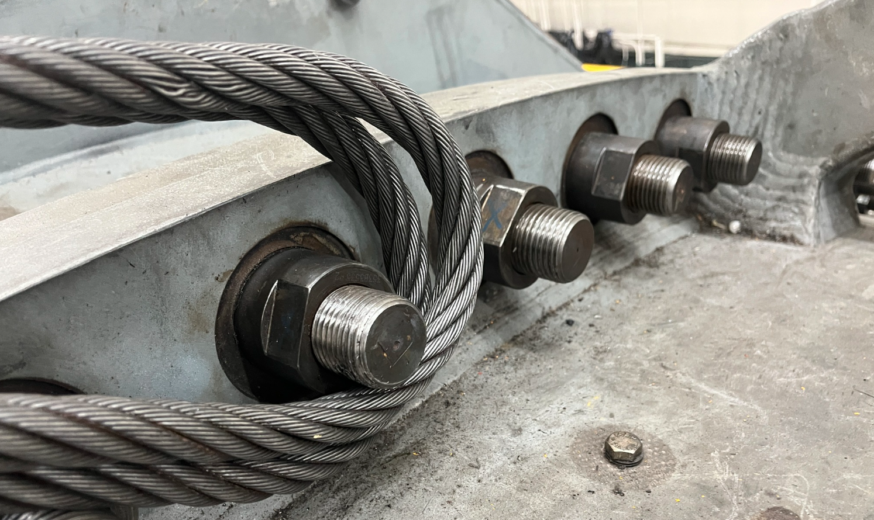
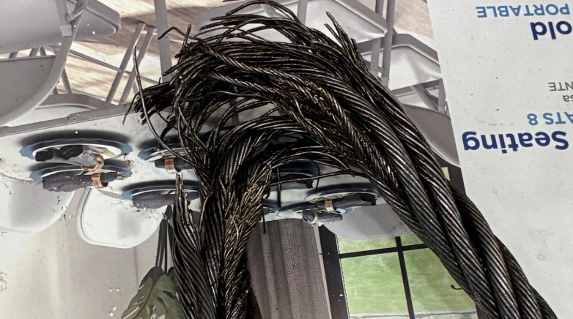
Level D/Near Miss
Houston Learning Center
July 29, 2026
N/A
The signal person who was on top of the compressor turbine shell, approximately 10ft away from the rigging did not notice the snagging of the wire rope on the stud.
The OH crane operator does not have visibility of the rigging and relying on the signal person’s communication from the top of the turbine. Thus, the OH crane operator continue the operation (cabling up), creating a tensile stress and tension to the ¾” wire rope that was snagged on the stud.
The snapping of the ¾” wire rope (force and energy) caused one of the 10t chain fall to break loose and dropped on top of the turbine then on to the platform. No one is injured when the chain fall fell to the platform.
Ensure all rigging equipment are visibly detached and cleared from any snagging prior to any movement of the OH crane.
Do not start work when there is no secondary verification of the rigging equipment clear from all or any potential snagging.
Stop work when there is no movement during the clearing and cabling up of the rigging equipment.
Secure all pull chains and place them in the bag prior to any movement of the crane.
Place a secondary exclusion zone to ensure no one is nearby when there is a potential rigging failure.
After installing the 7HA.03 exhaust frame, the crew were clearing up the rigging, and as the lifting team cabling up, the ¾” wire rope caught on (snag) the stud on the mini case of the exhaust frame causing the ¾” wire rope to snap and break. Due to the snapping of the wire rope, this resulted to one of the10T chain fall dropped on the platform. No one is injured during this event.
Do not Start Work when there is no secondary verification of all rigging equipment clear from any snagging
Notes:
Add PSE icon to Initial Notification slide header when applicable.

